Slide 1
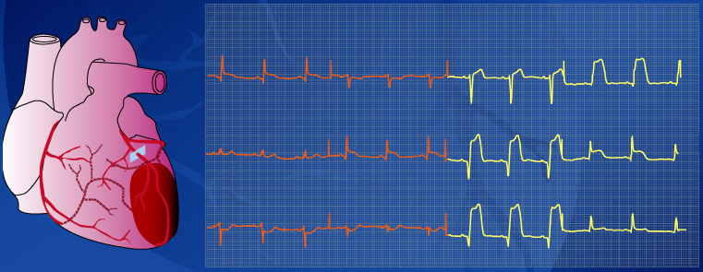
Anterior infarction
Anterior infarction
I II III
aVR aVL aVF
V1 V2 V3
V4 V5 V6
Left
coronary
artery
Notes:
Location of infarction and its relation to the ECG: anterior infarction
As was discussed in the previous module, the different leads look at different aspects of the heart, and so infarctions can be located by noting the changes that occur in different leads. The precordial leads (V_{1–6}) each lie over part of the ventricular myocardium and can therefore give detailed information about this local area. aVL, I, V₅ and V₆ all reflect the anterolateral part of the heart and will therefore often show similar appearances to each other. II, aVF and III record the inferior part of the heart, and so will also show similar appearances to each other. Using these we can define where the changes will be seen for infarctions in different locations.
Anterior infarctions usually occur due to occlusion of the left anterior descending coronary artery resulting in infarction of the anterior wall of the left ventricle and the intraventricular septum. It may result in pump failure due to loss of myocardium, ventricular septal defect, aneurysm or rupture and arrhythmias. ST elevation in I, aVL, and V_{2–6}, with ST depression in II, III and aVF are indicative of an anterior (front) infarction. Extensive anterior infarctions show changes in V_{1–6} , I, and aVL.

Slide 2
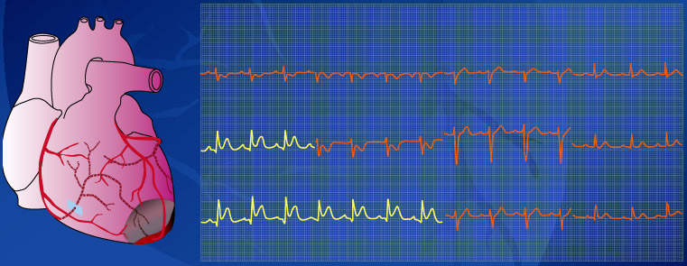
Inferior infarction
Inferior infarction
I II III
aVR aVL aVF
V1 V2 V3
V4 V5 V6
Right
coronary
artery
Notes:
Location of infarction and its relation to the ECG: inferior infarction
ST elevation in leads II, III and aVF, and often ST depression in I, aVL, and precordial leads are signs of an inferior (lower) infarction. Inferior infarctions may occur due to occlusion of the right circumflex coronary arteries resulting in infarction of the inferior surface of the left ventricle, although damage can be made to the right ventricle and interventricular septum. This type of infarction often results in bradycardia due to damage to the atrioventricular node.

Slide 3
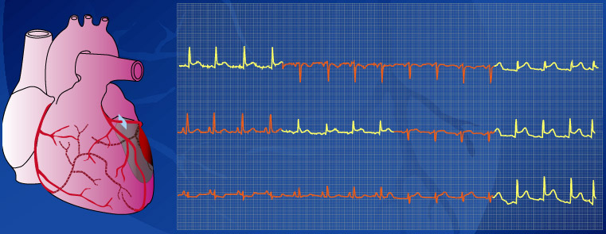
Lateral infarction
Lateral infarction
I II III
aVR aVL aVF
V1 V2 V3
V4 V5 V6
Left
circumflex
coronary
artery
Notes:
Location of infarction and its relation to the ECG: lateral infarction
Occlusion of the left circumflex artery may cause lateral infarctions.
Lateral infarctions are diagnosed by ST elevation in leads I and aVL.

Slide 4
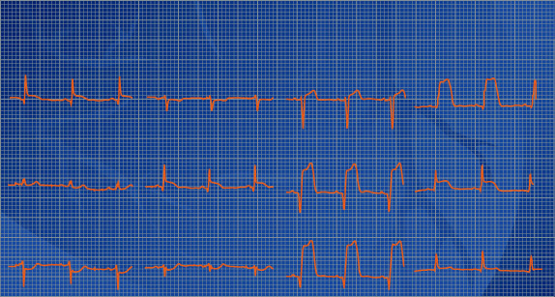
Location of infarct combinations
I
aVR
V1
V4
LATERAL
ANT
POST
ANT
SEPTAL
II
aVL
V2
V5
ANT
LAT
V3
V6
III
INFERIOR
aVF
Notes:
Location of infarction: combinations
The previous slides discussed the changes that occur in typical anterior, inferior and lateral infarctions. However, the area infarcted is not always limited to these areas and infarctions can extend across two regions. For example, an anterior infarction which is also on the lateral side of the heart is known as an anterolateral infarction.
ST segment elevation in leads I and aVL represent a lateral infarction
Anteroseptal infarctions show ST segment elevation in leads V₁ to V_{4.}
ST elevation in V₄ to V₆ is typical of an anterolateral infarction
ST elevation in II, III and aVF is typical of inferior infarction.

Slide 5
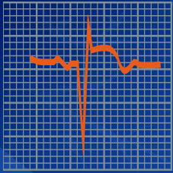
Diagnostic criteria for AMI
Q wave duration of more than 0.04 seconds
Q wave depth of more than 25% of ensuing r wave
ST elevation in leads facing infarct (or depression in opposite leads)
Deep T wave inversion overlying and adjacent to infarct
Cardiac arrhythmias
Notes:
Diagnostic criteria for AMI
Myocardial infarction is the loss of viable, electrically active myocardium. Diagnosis can therefore be made from the ECG. However, only changes in QRS complexes can provide a definite diagnosis. Changes in each of the leads must be noted, along with symptoms, as both are important in making a diagnosis.
Excluding leads aVR and III, Q wave duration of more than 0.04 seconds or depth of more than 25% of the ensuing r wave are proof of infarction. Other criteria are the development of QS waves and local area low voltage r waves.
Although these are useful diagnostic features, there are additional features that are associated with myocardial infarction as have been described in the previous slides. These include ST elevation in the leads facing the infarct, ST depression (reciprocal) in the opposite leads to the infarct, deep T wave inversion overlying and adjacent to the infarct, abnormally tall T waves facing the infarct, and cardiac arrhythmias. These extra features may aid in the diagnosis of myocardial infarction from an ECG.

Slide 6
Andere ECG patronen

Slide 7
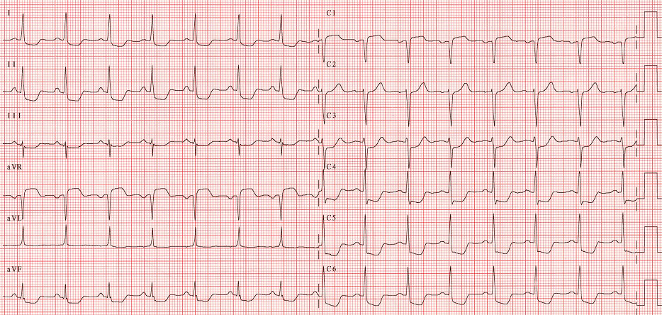
K 56b – Kritische hoofdstamstenose
Belangrijke ST segment depressie in 8 of meer afleidingen
ST segment elevatie in afl. V1 en aVR
Dyspnoe kan meer uitgesproken zijn
dan pijn tgv diastolisch hartfalen

Slide 8
- K 61Acute pericarditis
PR depression
ST elevation
concave up, ST/T V6 >.25, no reciprocal
DDx:
Acute MI
Early Repolarization
Myocarditis
Aneurysm
other: Brugada, BBB

Slide 9
Stage I everything is UP (i.e., ST elevation in almost all leads - see below)
Stage II Transition ( i.e., "pseudonormalization").
Stage III Everything is DOWN (inverted T waves).
Stage IV Normalization

Slide 10
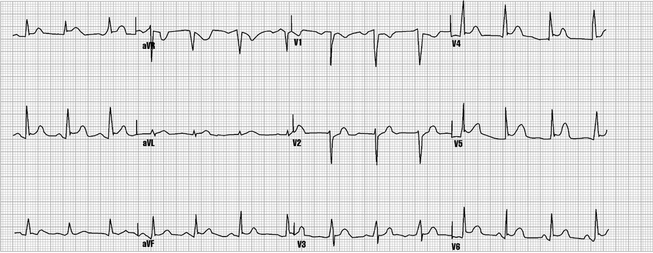
Pericarditis
Notes:
This ECG has ST elevations and some similarities to BER. However, in this case, BER is not present. This is an example of pericarditis.

Slide 11
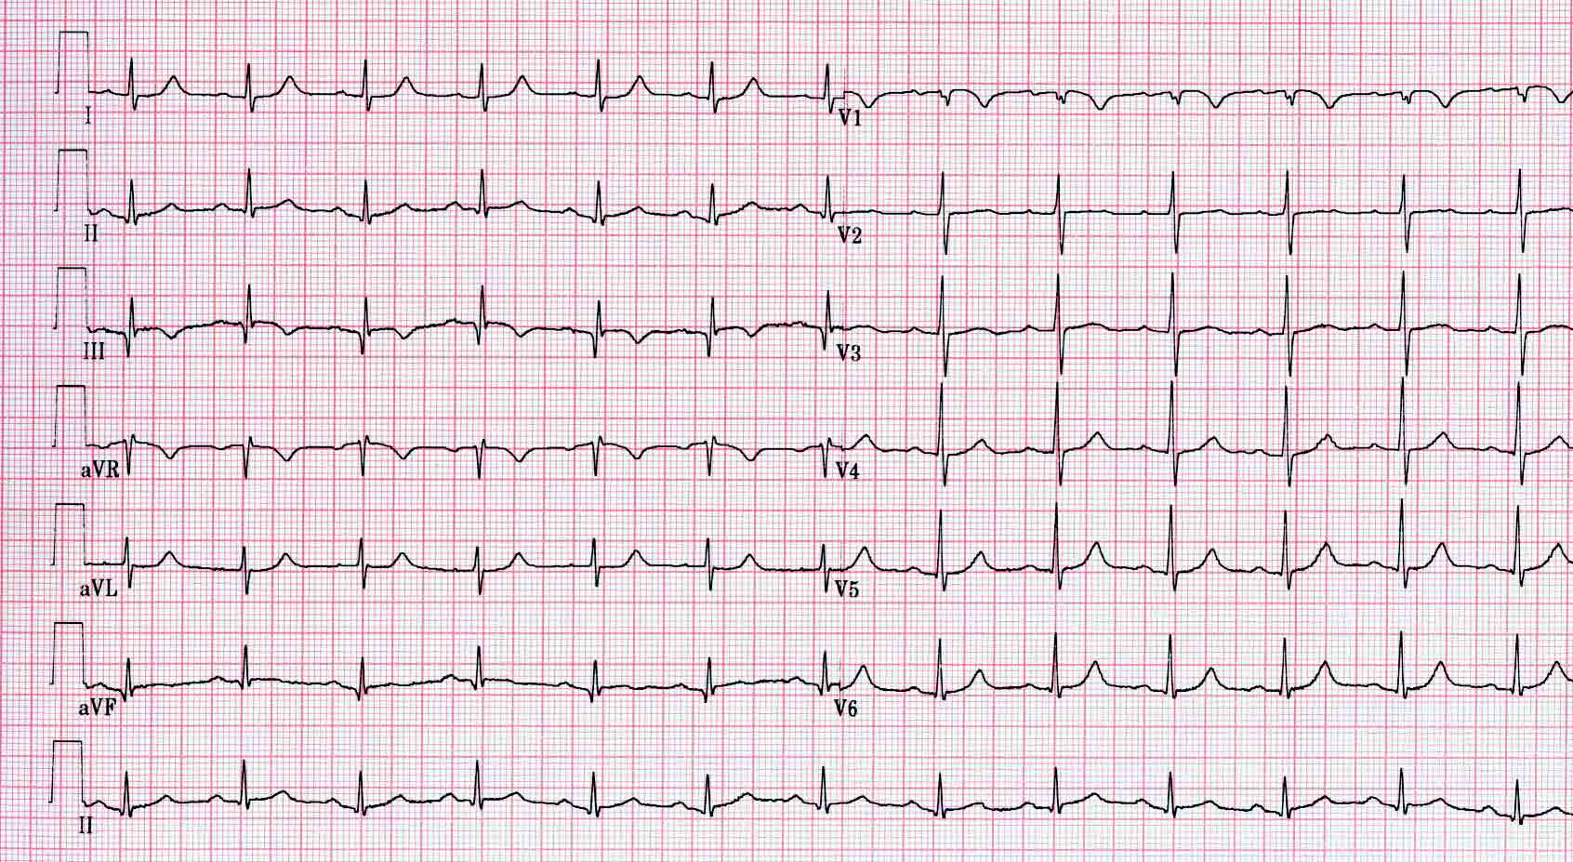
K62 - Acuut longembool
Sinustachycardie (8-69%) - VKF (0-35%)
P pulmonale (6-18%)
ORBTB (6-67%)
Rechterasdeviatie (3-66%)
Diepe S in I en aVL (28-73%)
qR in III & aVF (14-49%)
Δ-ST-T (49-77%): neg T in V1-V4, neg T in III & aVF
“S1Q3T3” (11-50%)
ECG afwijkingen zijn weinig specifiek en weinig sensitief (belang van kliniek!)

Slide 12
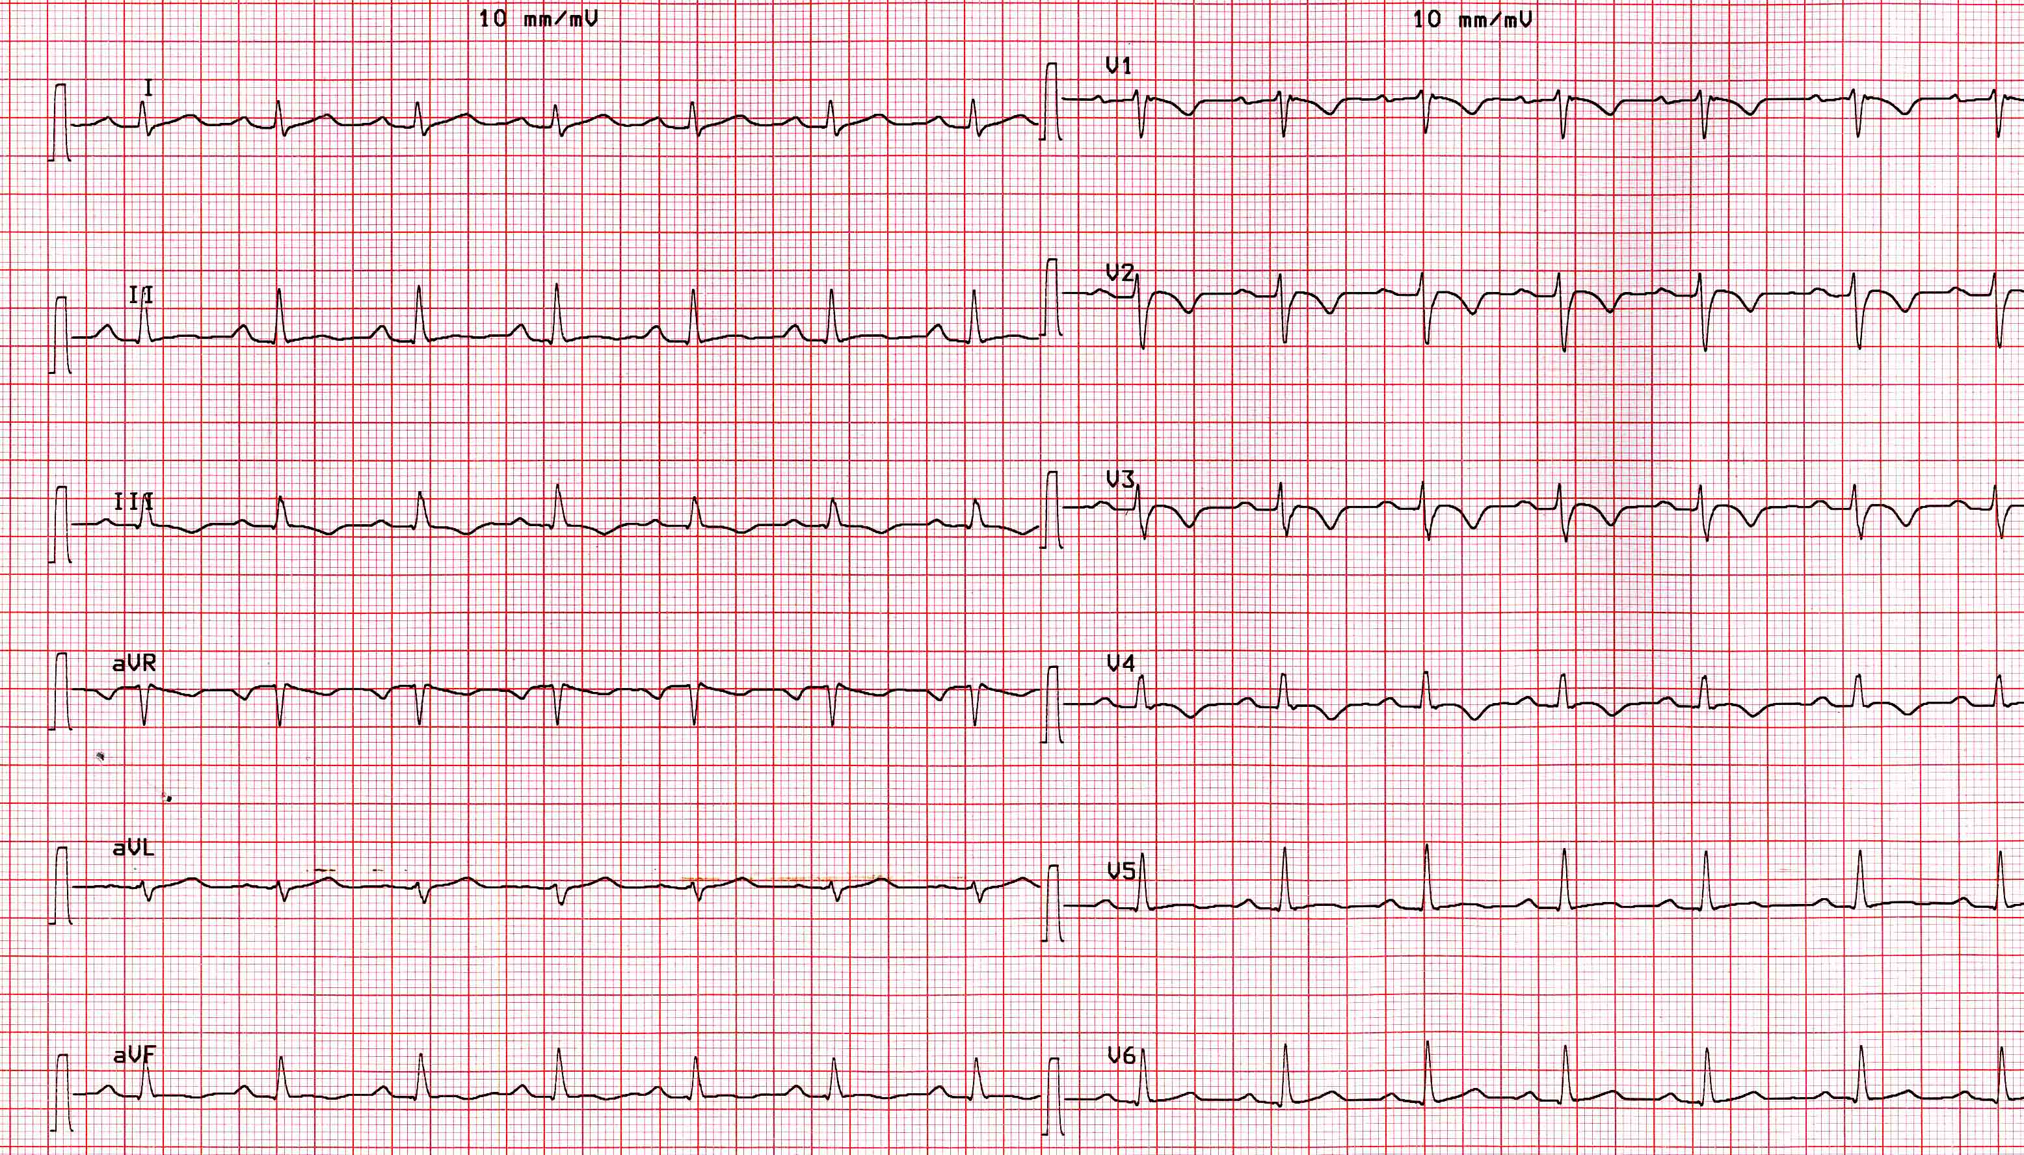
K63 - Aritmogene rechterkamer cardiomyopathie
Onvolledig RBTB
“Epsilon” golven in afl. V1 tot V3: laaggevolteerde fragmentatie op einde van QRS complex
Negatieve T toppen rechter precordialen
Vervanging van spierweefsel in de rechter kamer door vetweefsel en bindweefsel
Vaak gecompliceerd door ventrikeltachycardie uit de rechter kamer (LBTB morfologie)

Slide 13
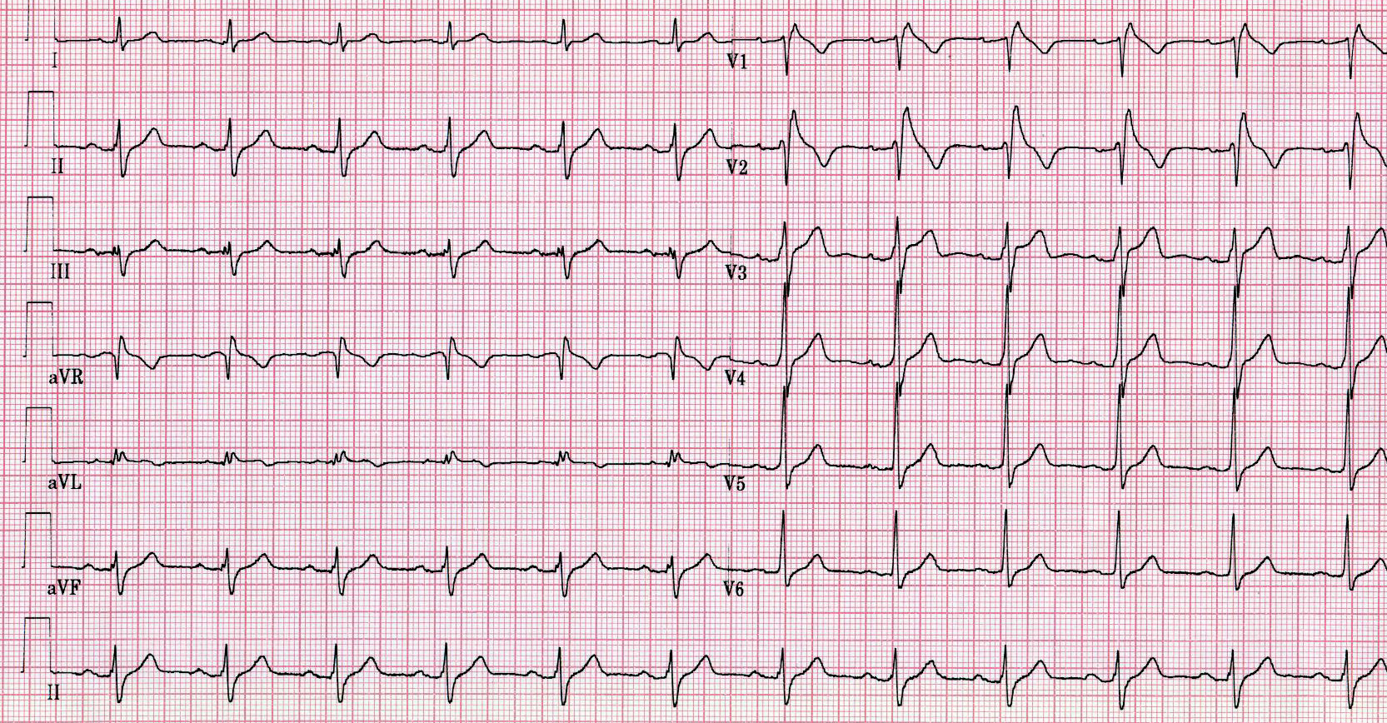
K64 - Brugada syndroom (BS)
ECG afwijking kan transient zijn
“RBTB” patroon maar enkel in V1-V3
Prominente J golf in V1-V3
Convexe ST segment elevatie (“coved”) doorlopend in een negatieve T golf in V1-V3
Verhoogd risico op plotse dood
Familiaal autosomaal dominant, defect in natriumkanaal (SCN5A,...)
Variable expressie en penetrantie
1/2000, vnl. mannen (9:1)

Slide 14
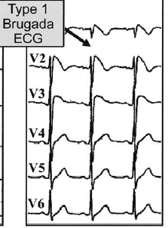
Type I- Diagnostic
V1-V3 (as least two leads) ST segment elevation >2mm, “coved” shape, inverted T-wave.
Coupled with
Documented VFib
Polymorphic VT
FH of sudden cardiac death <45 yo
Type I EKG in family members
VT inducable in EP lab
Syncope
Nocturnal agonal respiration

Slide 15
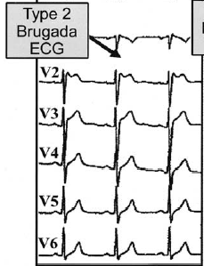
Types II and III- Suggestive
II: V1-V3 ST segment elevation >2mm, “saddleback” shape, pos or biphasic T.
III: <1 mm elevation, either coved or saddleback.

Slide 16
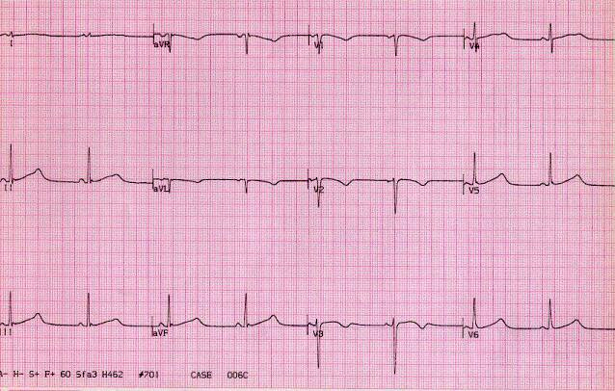
K65 - Lang QT syndroom (LQTS)
QTc > 440 ms (man), QTc > 460 ms (vrouw)
Brede of gehaakte T golf
Familiaal LQTS (aangeboren channelopathie):
1/5000
14 types (Na, K); 90% LQTS 1, 2 en 3
Verworven LQTS:
medicatie (www.QTdrugs.org): anti-aritmica, antidepressiva, antibiotica, antihistaminica,…
elektrolyten: hypokaliëmie,…

Slide 17
K67 - Hyperkaliëmie
Spitse, smalle T golven (zoals bij acute ischemie) met kort QT interval (i.t.t. tot ischemie)
P golf: breed, vermindering in amplitude tot verdwijnen van P golf
PR: verlenging
QRS: “slurring” i.e. terminaal deel verbreed
ST segment: “merging” tussen QRS en T (i.e. S loopt door in T zonder onderbreking)
T golf: “tenting” (i.e. hoge T golf)
“Slurring, merging, tenting”

Slide 18
ECG Variants due to Drugs or Electrolytes Imbalances
Hypokalemia: lg U waves ( usually taller than T) seen best in precordial leads. <2.7
Hyperkalemia:
Tall peaked T waves > 6.0
PR prolongs, QRS widens
P waves disappear > 8.0
Hypocalcemia:
Prolonged QT interval
Hypercalcemia:
Shortened QT interval
Digitalis effect:
ST depression- downsloping, curved ST segments.
“scooping”, “sagging”, flat or inverted T’s in lateral leads
PR prolonged
QT shortened

Slide 19
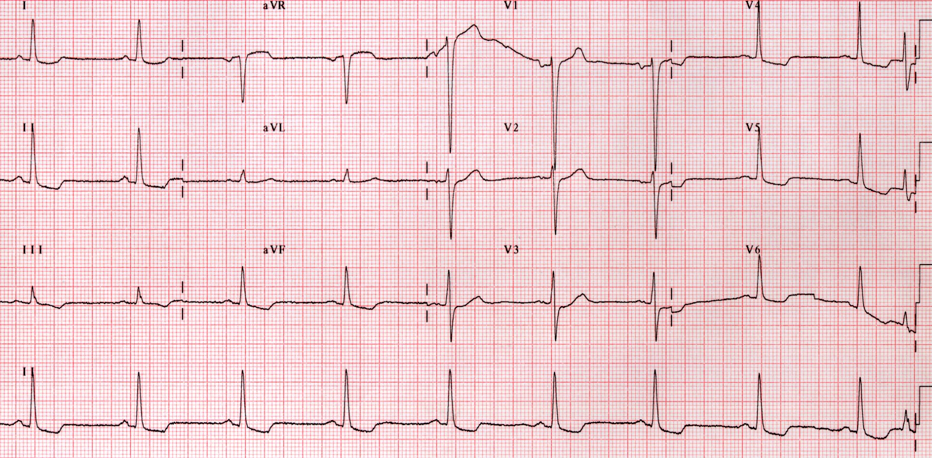
K68 - Digitaliseffect
Digitalis impregnatie:
ST decalage concaaf naar boven toe
Vermindering T top amplitude
Zwak positieve of asymmetrisch negatieve T golf
Digitalis intoxicatie:
Sino-atriaal blok
Ectopsich atriale tachycardie met AV blok
Atriale fibrillatie met totaal AV blok
Ventriculaire extrasystoles (PVC)
Ventrikeltachycardie (VT)

Slide 20
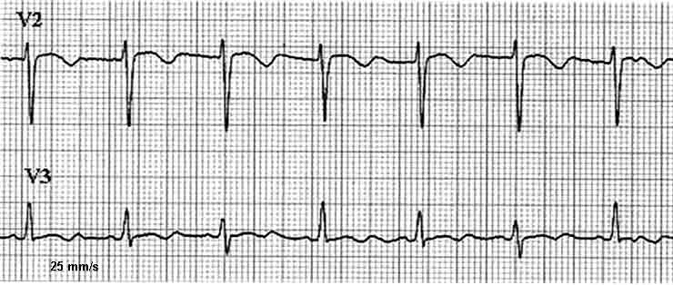
K88 - QRS alternans
Definitie: slag om slag verandering van QRS morfologie
Oorzaken:
- Massieve pericardvochtuitstorting (swinging heart, tamponade)
- SVT (AVRT, AT, AVNRT) bij snelle hartfrequenties, meest frequent bij AVRT
- Alternerend sinusritme en pre-excitatie
- CPMVT: catecholaminerge polymorfe VT
- VT of snelle ventr. pacing met 2/1 VA blok
- VT: enkele focus met 2 exits
QRS alternans t.g.v. harttamponade

Slide 21
EKG bij PM patienten

Slide 22
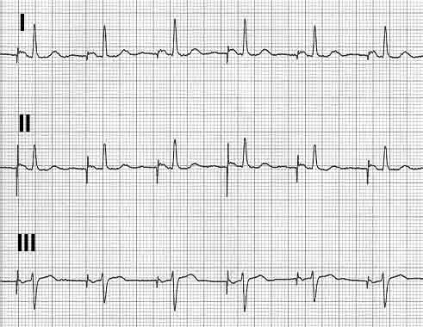
K70 - Atriale pacing
De pacemaker stimuleert enkel in de voorkamer
Iedere P golf wordt voorafgegaan door een atriale stimulus
De pacemaker-geïnduceerde P golf wordt gevolgd door een eigen spontaan QRS complex

Slide 23
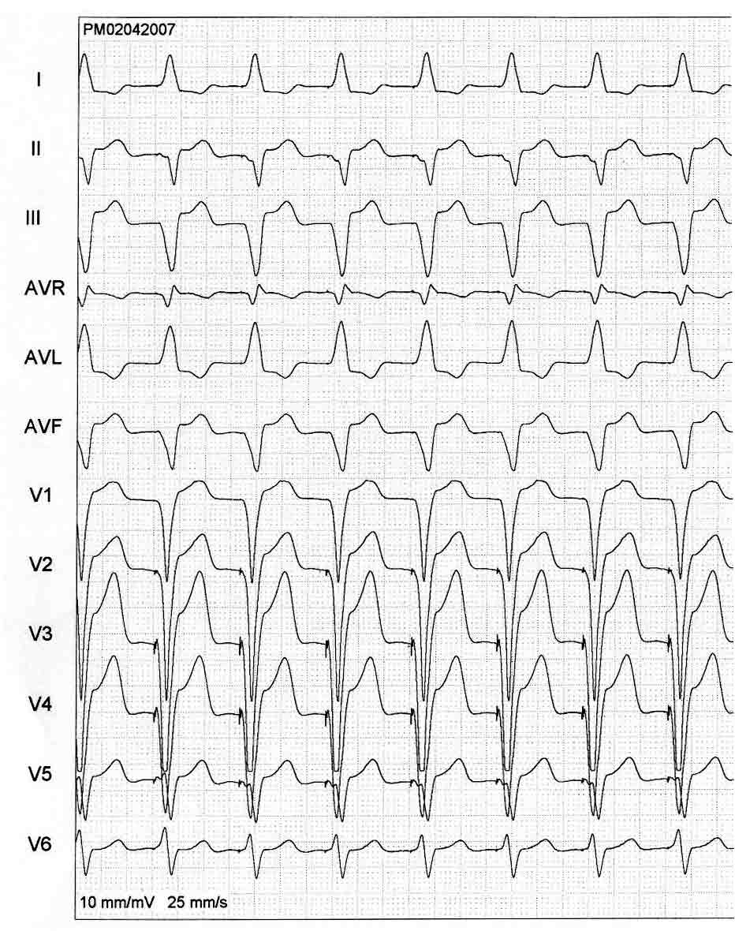
K71 - Ventriculaire pacing
Ventriculaire pacing uit de apex van het RV
Beeld van VLBTB in afleiding V1 (negatief)
QRS complex positief in afl.I en negatief in de inferior afleidingen II, III & aVF

Slide 24
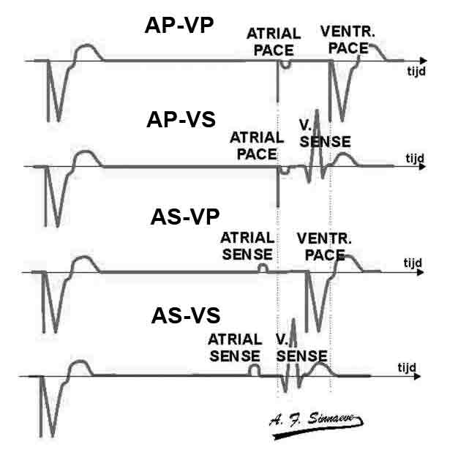
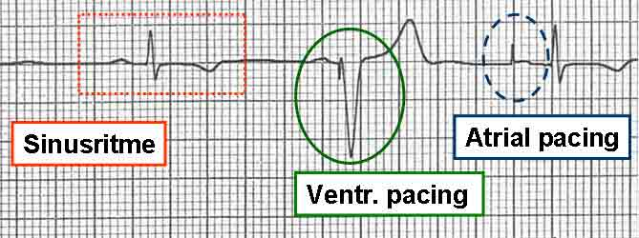
K72 - DDD pacing: ECG patronen
AP: atriale pacing; VP: ventriculaire pacing
AS: atriale sensing; VS: ventriculaire sensing

Slide 25
K72 - DDD pacing: PM tachycardie
Een pacemakertachycardie (of eindloze lustachycardie) is een cirkeltachycardie waarbij de antegrade geleiding gevormd wordt door het AV interval van de pacemaker. De prikkel keert terug van het ventrikel naar het atrium via retrograde geleiding over de AV knoop (VA interval)
Een P golf wordt niet gevoeld. De daaropvolgende atriale stimulus is niet effectief daar het atrium nog refractair is. Dit leidt tot een verlengd PR interval. Na ventr. pacing onstaat er een retrograde P golf die door de pacemaker wordt gevoeld en vervolgens wordt het ventrikel terug gestimuleerd en ontstaat er een PM tachycardie.

Slide 26
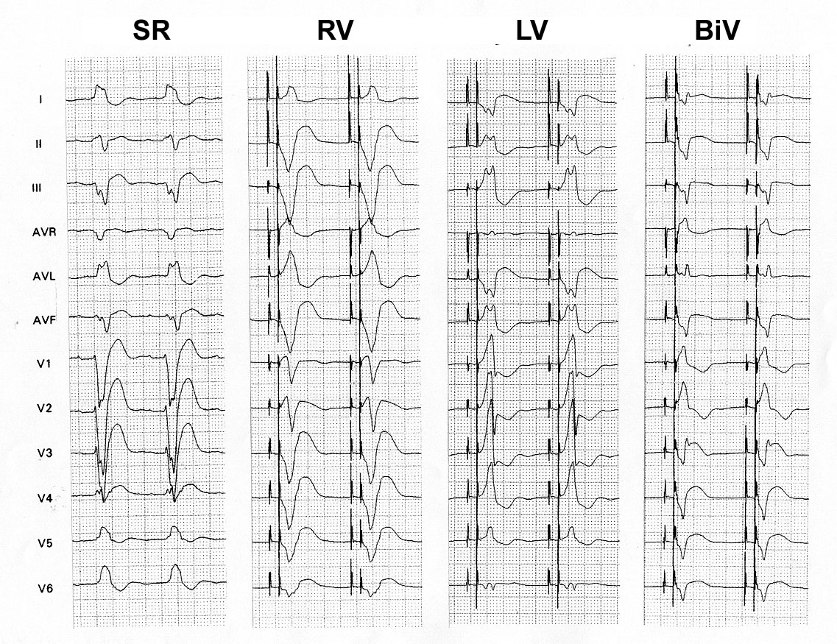
K73 - Biventriculaire pacing
Ventriculaire pacingstimulus
Initiële postieve deflexie in afl. V1 (type VRBTB)
Initiële negatieve deflexie in afl. I (QR,qR)
SR: sinusritme met VLBTB; RV: RV pacing (apex); LV: LV pacing; BiV: biventriculaire pacing

